Slide 1

Roderic Bouesse 28/11/2021

Slide 2

Outline
• Executive Summary
• Introduction
• Methodology
• Results
• Conclusion
• Appendix
2

Slide 3
Executive Summary
• Summary of methodologies
• Data Collection via API, Web Scraping
• Exploratory Data Analysis (EDA) with Data Visualization
• EDA with SQL
• Interactive Map with Folium
• Dashboards with Plotly Dash
• Predictive Analysis
• Summary of all results
• Exploratory Data Analysis results
• Interactive maps and dashboard
• Predictive results
3

Slide 4
Introduction
• Project background and context
• The aim of this project is to predict if the Falcon 9 first stage will successfully land. SpaceX says
on its website that the Falcon 9 rocket launch cost 62 million dollars. Other providers cost upward of 165 million dollars each. The price difference is explained by the fact that SpaceX can reuse the first stage. By determining if the stage will land, we can determine the cost of a launch. This information is interesting for another company if it wants to compete with SpaceX for a rocket launch.
• Problems you want to find answers
• What are the main characteristics of a successful or failed landing ?
• What are the effects of each relationship of the rocket variables on the success or failure of a
landing ?
• What are the conditions which will allow SpaceX to achieve the best landing success rate ?
4

Slide 5

5

Slide 6
Methodology
Executive Summary
• Data collection methodology:
• SpaceX REST API
• Web Scrapping from Wikipedia
• Perform data wrangling
• Dropping unnecessary columns
• One Hot Encoding for classification models
• Perform exploratory data analysis (EDA) using visualization and SQL
• Perform interactive visual analytics using Folium and Plotly Dash
• Perform predictive analysis using classification models
• How to build, tune, evaluate classification models
6

Slide 7
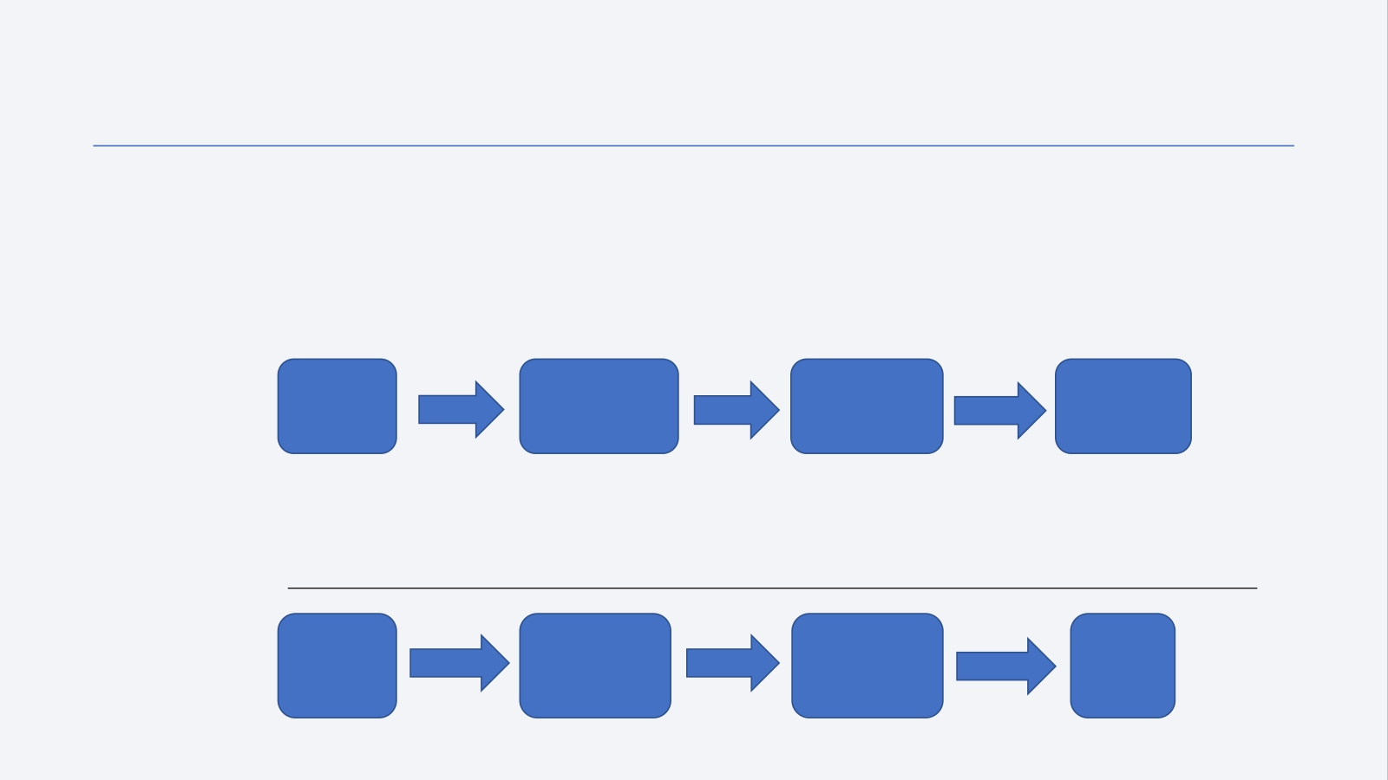
Data Collection
• Datasets are collected from Rest SpaceX API and webscrapping Wikipedia
• The information obtained by the API are rocket, launches, payload information.
• The Space X REST API URL is api.spacexdata.com/v4/
SpaceX
Rest API
call
Make Dataframe from JSON
Clean Data
and export
it
API returns
JSON file
• The information obtained by the webscrapping of Wikipedia are launches, landing,
payload information.
• URL is https://en.wikipedia.org/w/index.php?title=List_of_Falcon_9_and_Falcon_Heavy_launches&oldid=1027686922
Get HTML
response
from
Wikipedia
Extract data
with
BeautifulSoup
Make
Dataframe
Export
Data
7

Slide 8
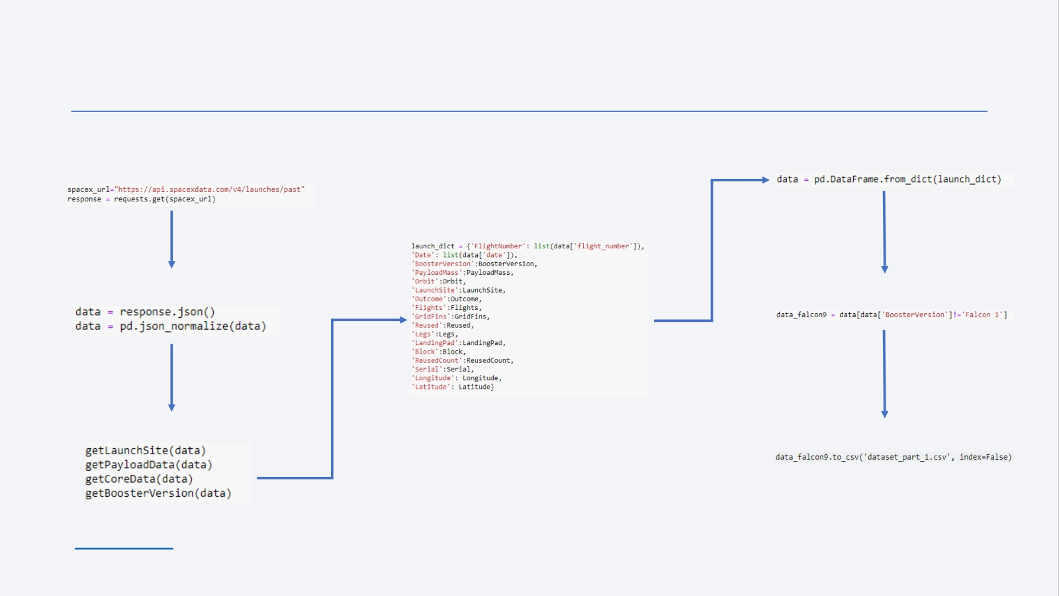
Data Collection – SpaceX API
1. Getting Response from API
4. Create dictionary with data
2. Convert Response to JSON File
3. Transform data
5. Create dataframe
6. Filter dataframe
7. Export to file
Link to code 8

Slide 9
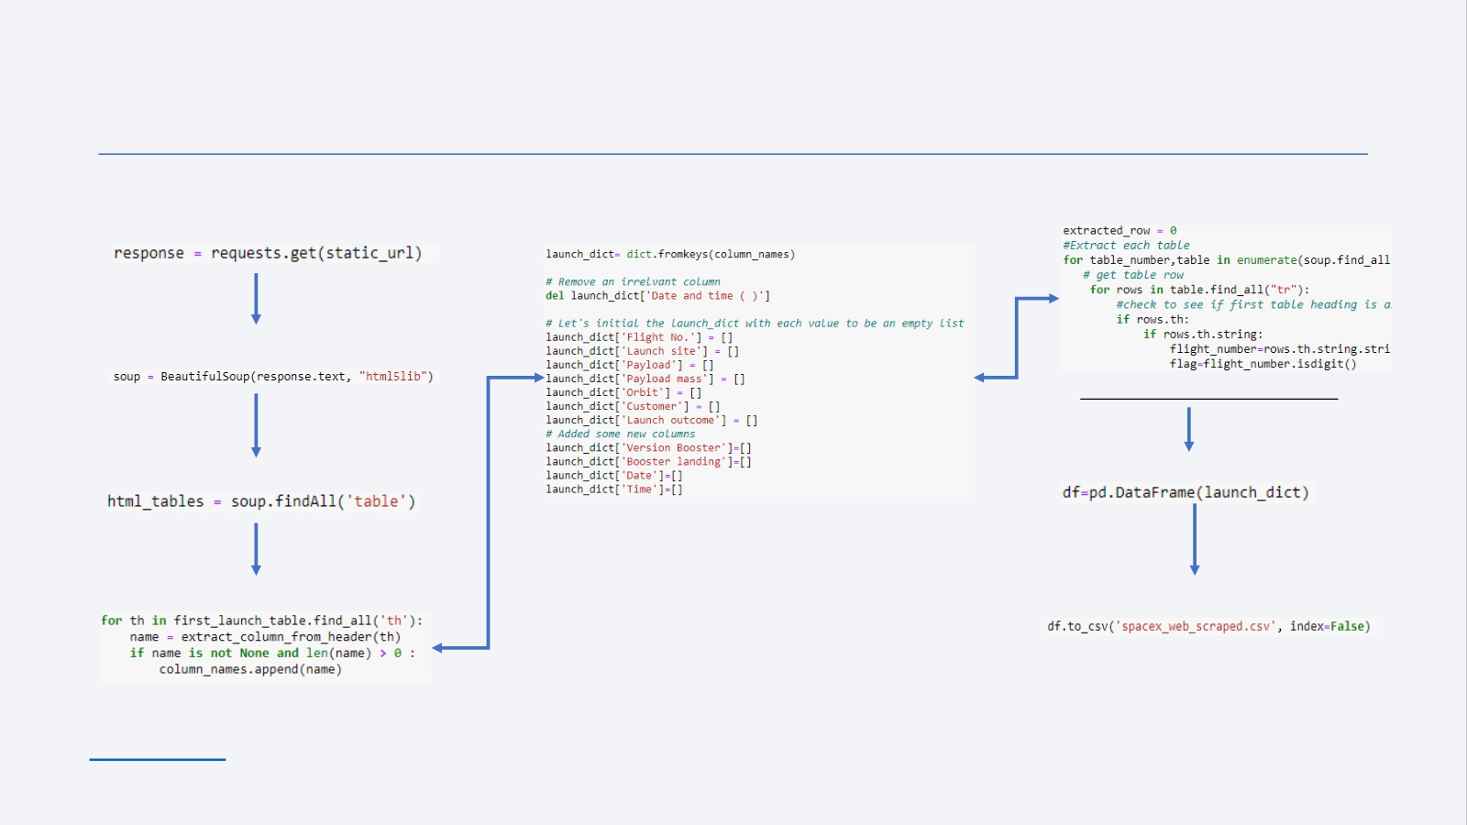
Data Collection - Scraping
6. Add data to keys
See notebook for the rest of code
7. Create dataframe from dictionary
8. Export to file
9
1. Getting Response from HTML
2. Create BeautifulSoup Object
3. Find all tables
4. Get column names
Link to code
5. Create dictionary

Slide 10
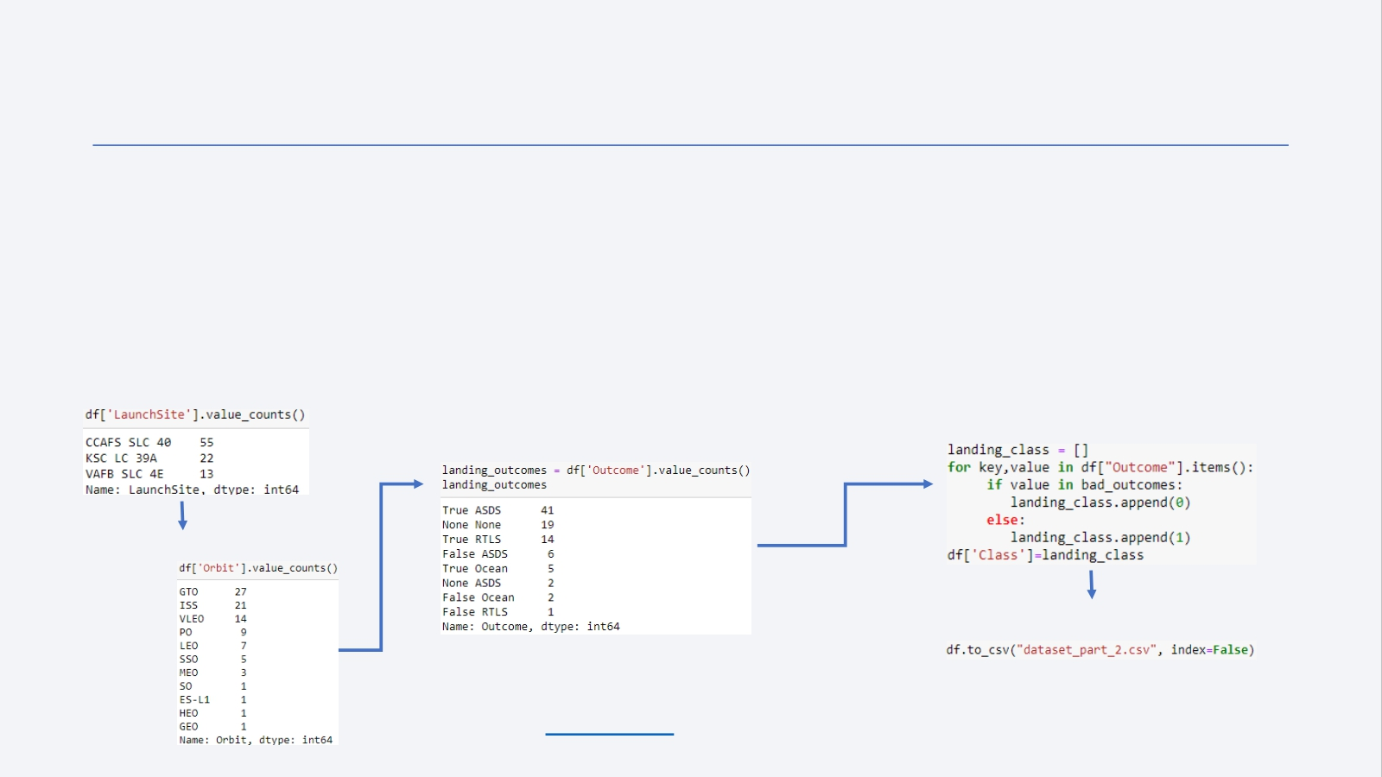
Data Wrangling
• In the dataset, there are several cases where the booster did not land successully.
• True Ocean, True RTLS, True ASDS means the mission has been successful.
• False Ocean, False RTLS, False ASDS means the mission was a failure.
• We need to transform string variables into categorical variables where 1 means the
mission has been successful and 0 means the mission was a failure.
1. Calculate launches number for each site
2. Calculate the number and occurence of each orbit
3. Calculate number and occurrence of mission outcome per orbit type
4. Create landing outcome label from Outcome column
5. Export to file
Link to code 10

Slide 11

EDA with Data Visualization
• Scatter Graphs
• Flight Number vs. Payload Mass
• Flight Number vs. Launch Site
• Payload vs. Launch Site
• Orbit vs. Flight Number
• Payload vs. Orbit Type
• Orbit vs. Payload Mass
Scatterplotsshowrelationshipbetween variables.Thisrelationshipiscalledthecorrelation.
• Bar Graph
• Success rate vs. Orbit
Bargraphsshowtherelationshipbetween numericandcategoricvariables.
• Line Graph
• Success rate vs. Year
Linegraphsshowdatavariablesandtheirtrends. Linegraphscanhelptoshowglobalbehavior andmakepredictionforunseendata.
Link to code 11

Slide 12

EDA with SQL
• We performed SQL queries to gather and understand data from dataset:
• Displaying the names of the unique lauunch sites in the space mission.
• Display 5 records where launch sites begin with the string 'CCA'
• Display the total payload mass carried by boosters launched by NASA (CRS).
• Display average payload mass carried by booster version F9 v1.1.
• List the date when the first successful landing outcome in ground pad was achieved.
• List the names of the boosters which have success in drone ship and have payload mass greater than 4000 but less than 6000.
• List the total number of successful and failure mission outcomes.
• List the names of the booster_versions which have carried the maximum payload mass.
• List the records which will display the month names, faiilure landing_ouutcomes in drone ship, booster versions, launch_site for the
months in year 2015.
• Rank the count of successful landiing_outcomes between the date 04-06-2010 and 20-03-2017 in descending order.
Link to code 12

Slide 13

Build an Interactive Map with Folium
• Folium map object is a map centered on NASA Johnson Space Center at Houson, Texas
• Red circle at NASA Johnson Space Center's coordinate with label showing its name (folium.Circle,folium.map.Marker).
• Red circles at each launch site coordinates with label showing launch site name (folium.Circle,folium.map.Marker,
folium.features.DivIcon).
• The grouping of points in a cluster to display multiple and different information for the same coordinates
(folium.plugins.MarkerCluster).
• Markers to show successful and unsuccessful landings. Green for successful landing and Red for unsuccessful landing.
(folium.map.Marker,folium.Icon).
• Markers to show distance between launch site to key locations (railway, highway, coastway, city) and plot a line between them . (folium.map.Marker,folium.PolyLine,folium.features.DivIcon)
• These objects are created in order to understand better the problem and the data. We can show easily
all launch sites, their surroundings and the number of successful and unsuccessful landings.
Link to code 13

Slide 14

Build a Dashboard with Plotly Dash
• Dashboard has dropdown, pie chart, rangeslider and scatter plot components
• Dropdown allows a user to choose the launch site or all launch sites
(dash_core_components.Dropdown).
• Pie chart shows the total success and the total failure for the launch site chosen with the
dropdown component (plotly.express.pie).
• Rangeslider allows a user to select a payload mass in a fixed range (dash_core_components.RangeSlider).
• Scatter chart shows the relationship between two variables, in particular Success vs
Payload Mass (plotly.express.scatter).
Link to code
14

Slide 15

Predictive Analysis (Classification)
• Data preparation
• Load dataset
• Normalize data
• Split data into training and test sets.
• Model preparation
• Selection of machine learning algorithms
• Set parameters for each algorithm to GridSearchCV
• Training GridSearchModel models with training dataset
• Model evaluation
• Get best hyperparameters for each type of model
• Compute accuracy for each model with test dataset
• Plot Confusion Matrix
• Model comparison
• Comparison of models according to their accuracy
• The model with the best accuracy will be chosen (see Notebook for result)
Link to code
15

Slide 16
Results
• Exploratory data analysis results
• Interactive analytics demo in screenshots
• Predictive analysis results
16

Slide 17


Slide 18
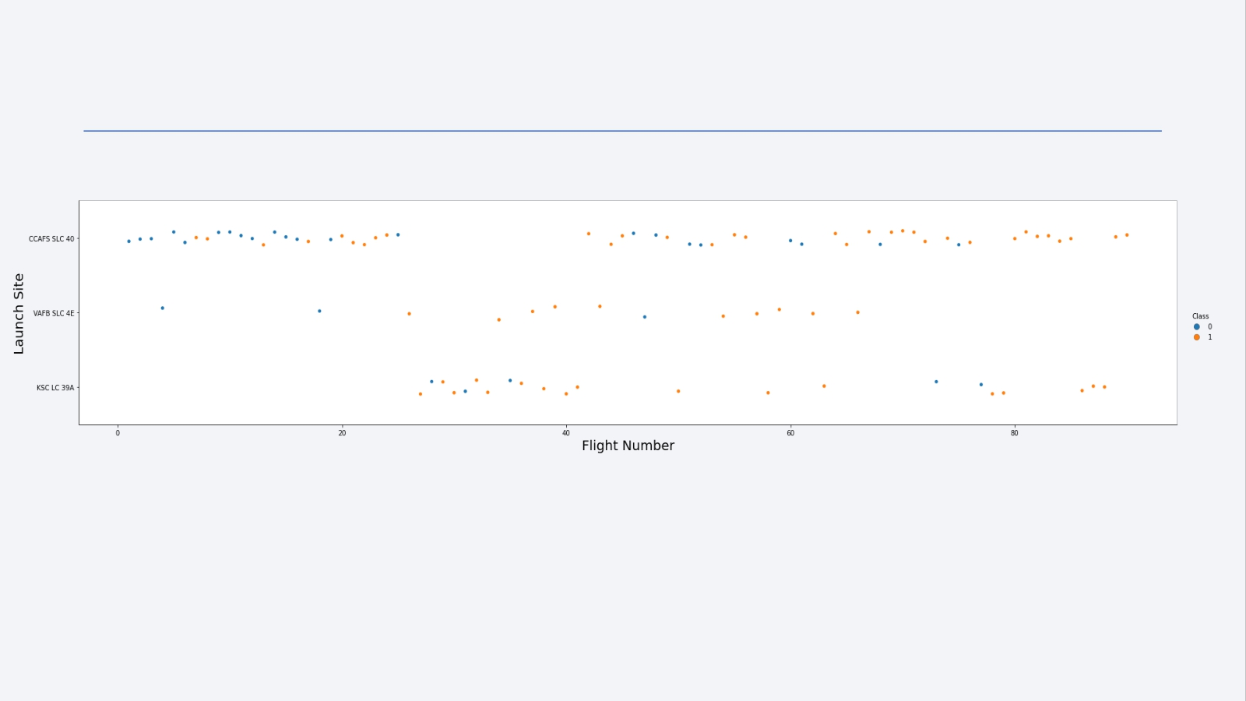
Flight Number vs. Launch Site
We observe that, for each site, the success rate is increasing.
18

Slide 19
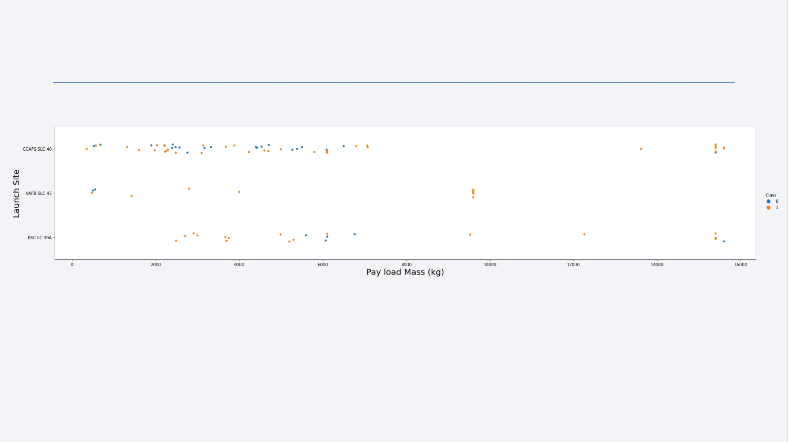
Payload vs. Launch Site
Depending on the launch site, a heavier payload may be a consideration for a successful landing. On the other hand, a too heavy payload can make a landing fail.
19

Slide 20
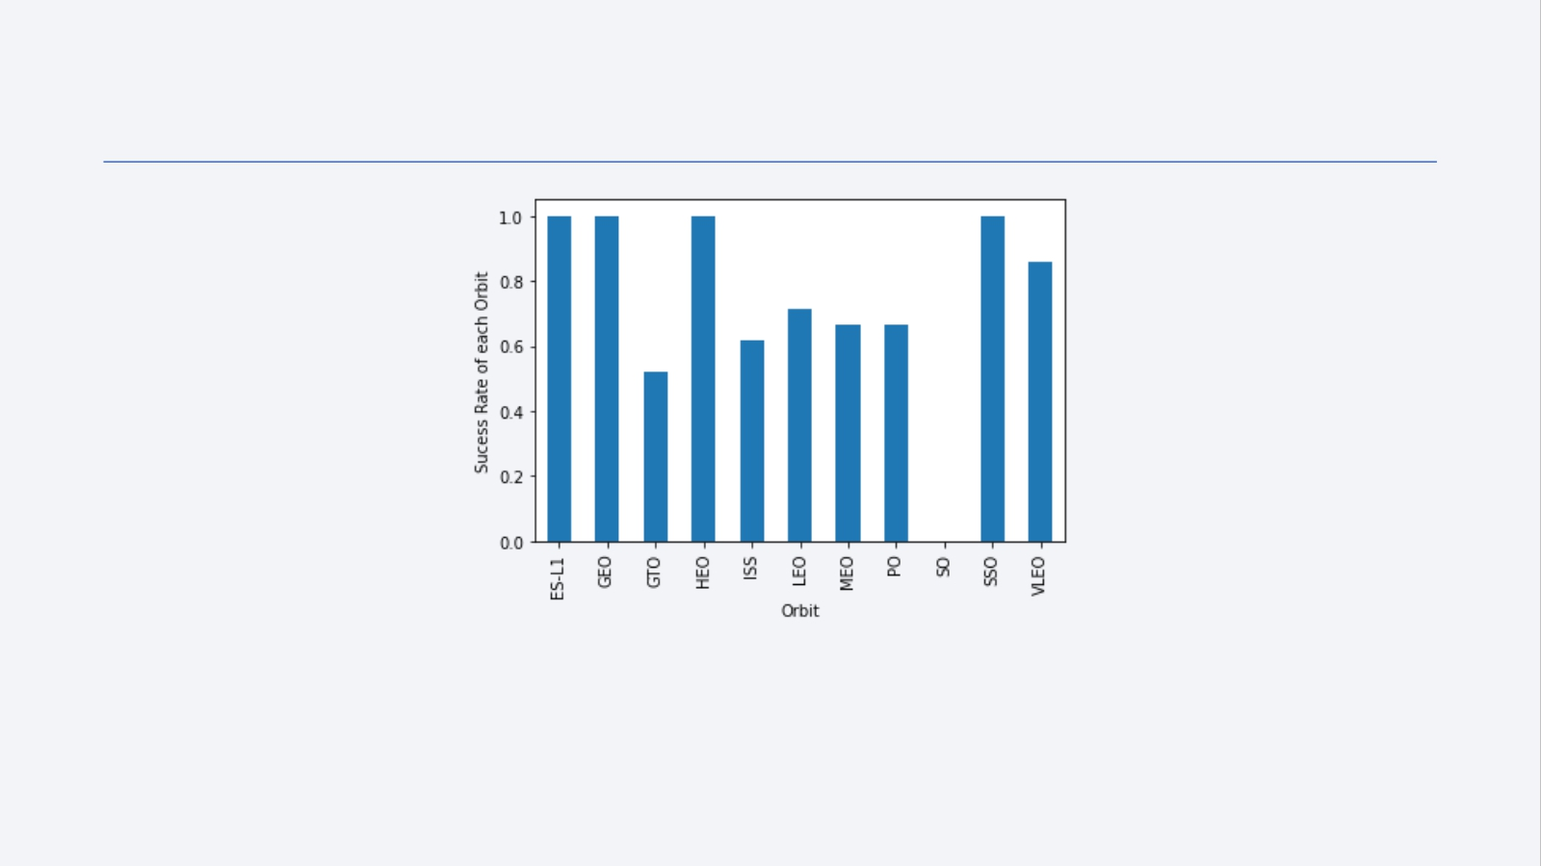
Success Rate vs. Orbit Type
With this plot, we can see success rate for different orbit types. We note that ES-L1, GEO, HEO, SSO have the best success rate.
20

Slide 21
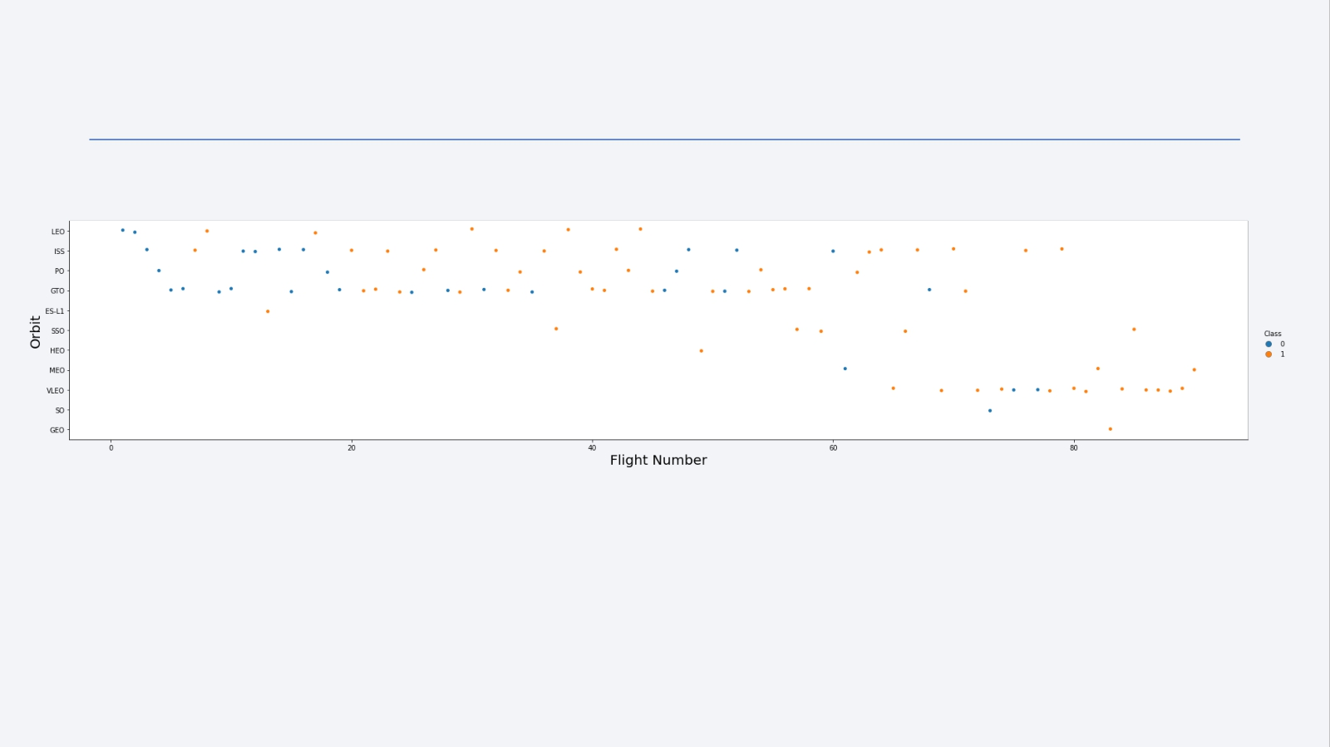
Flight Number vs. Orbit Type
We notice that the success rate increases with the number of flights for the LEO orbit. For some orbits like GTO, there is no relation between the success rate and the number of flights. But we can suppose that the high success rate of some orbits like SSO or HEO is due to the knowledge learned during former launches for other orbits.
21

Slide 22
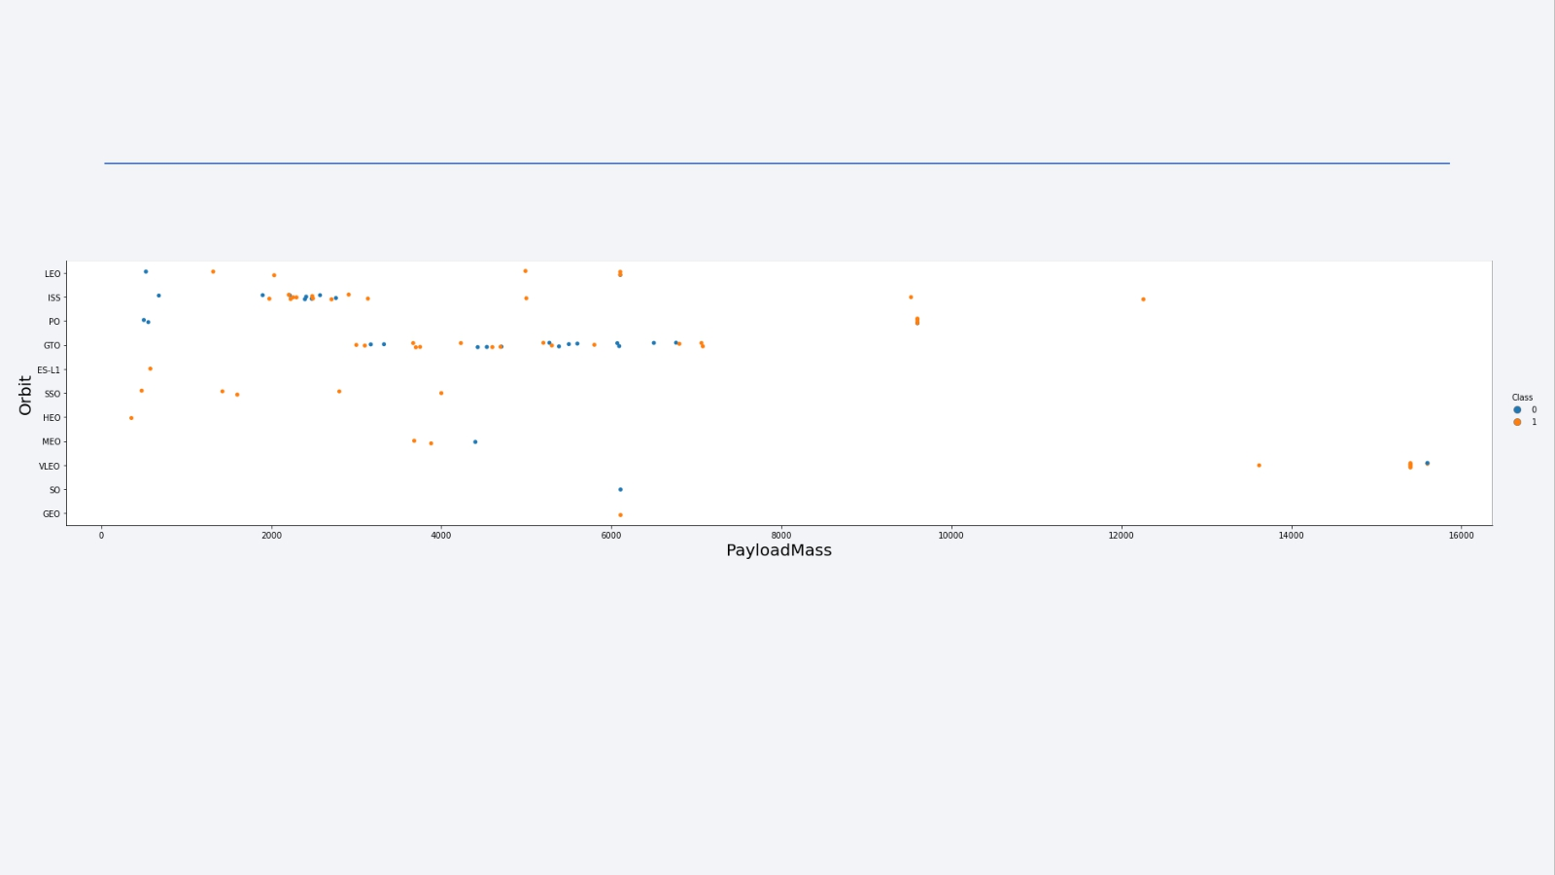
Payload vs. Orbit Type
The weight of the payloads can have a great influence on the success rate of the launches in certain orbits. For example, heavier payloads improve the success rate for the LEO orbit. Another finding is that decreasing the payload weight for a GTO orbit improves the success of a launch.
22

Slide 23
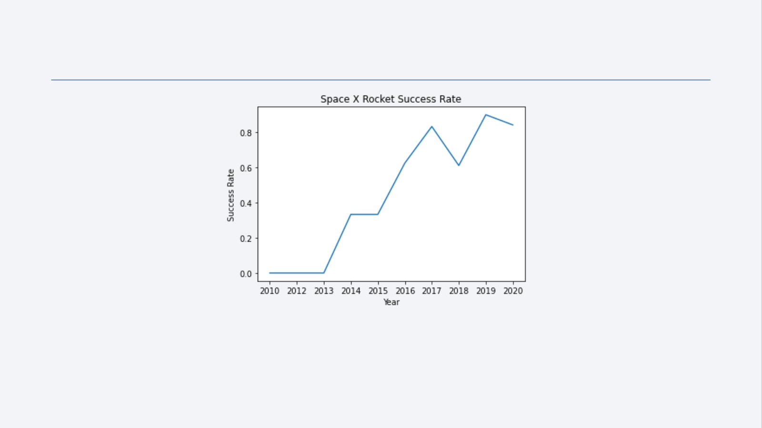
Launch Success Yearly Trend
Since 2013, we can see an increase in the Space X Rocket success rate.
23

Slide 24
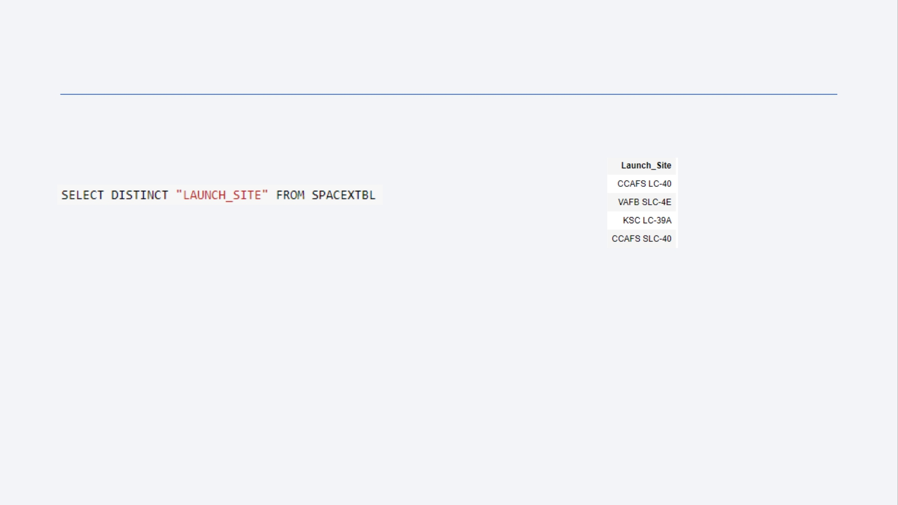
All Launch Site Names
SQL Query
Results
Explanation
The use of DISTINCT in the query allows to remove duplicate LAUNCH_SITE.
24

Slide 25
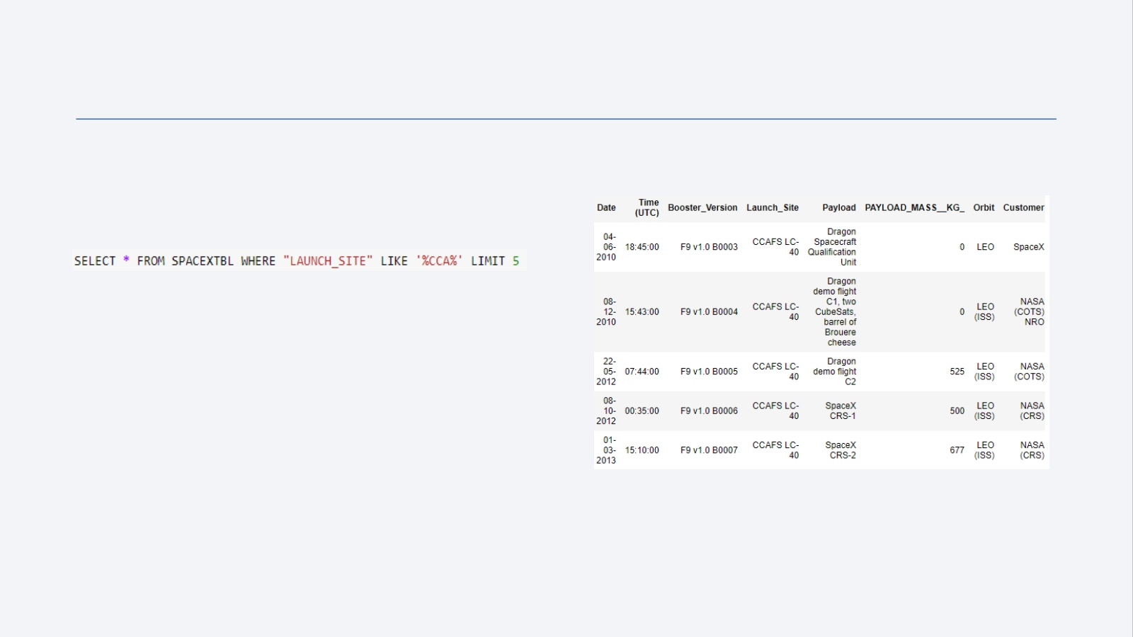
Launch Site Names Begin with 'CCA'
SQL Query Results
Explanation
The WHERE clause followed by LIKE clause filters launch sites that contain the substring CCA. LIMIT 5 shows 5 records from filtering.
25

Slide 26
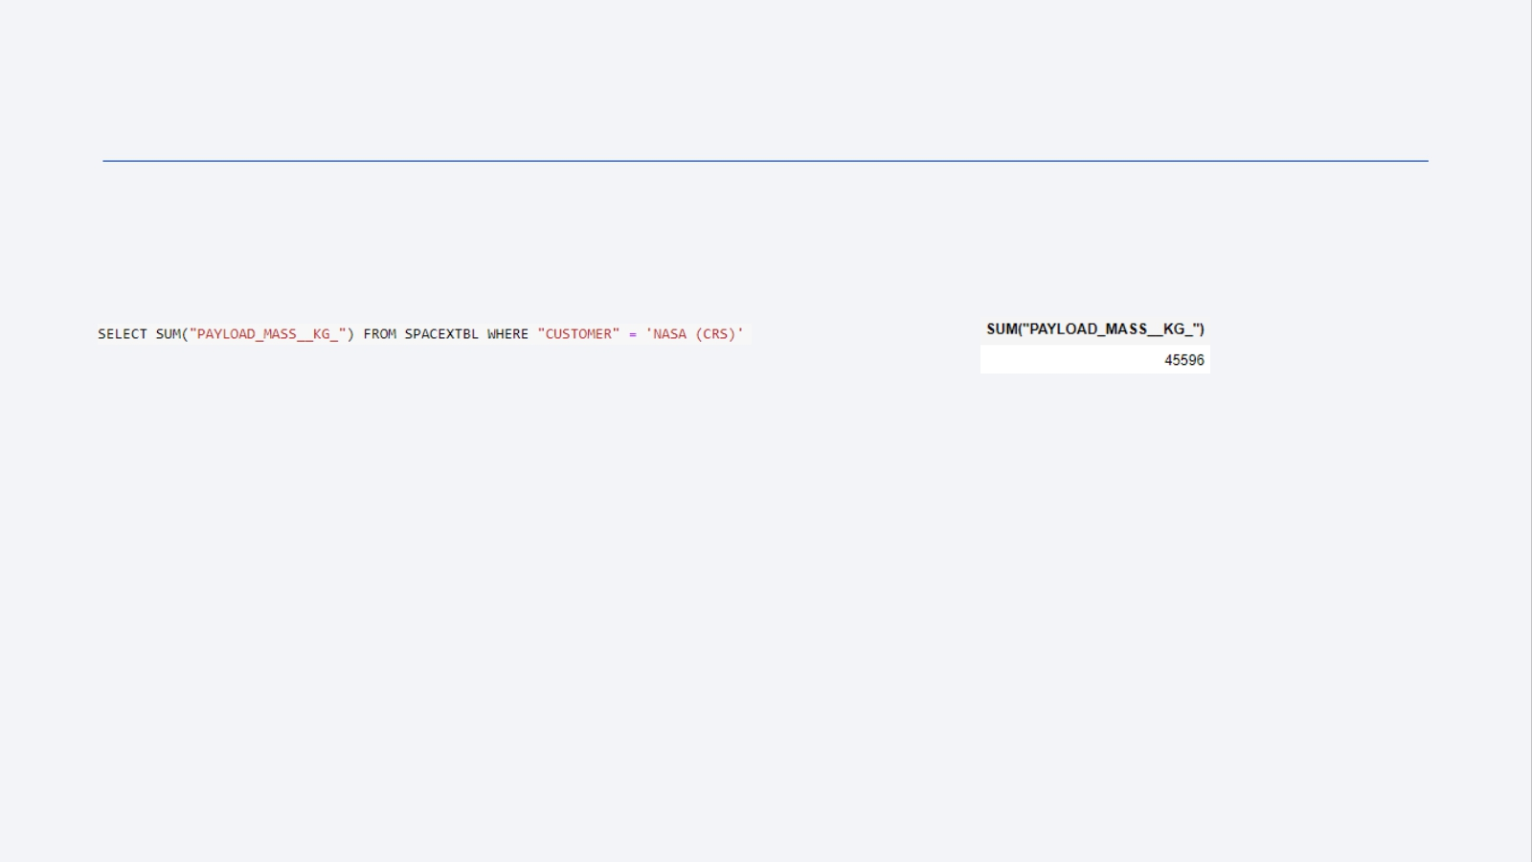
Total Payload Mass
SQL Query
Results
Explanation
This query returns the sum of all payload masses where the customer is NASA (CRS).
26

Slide 27
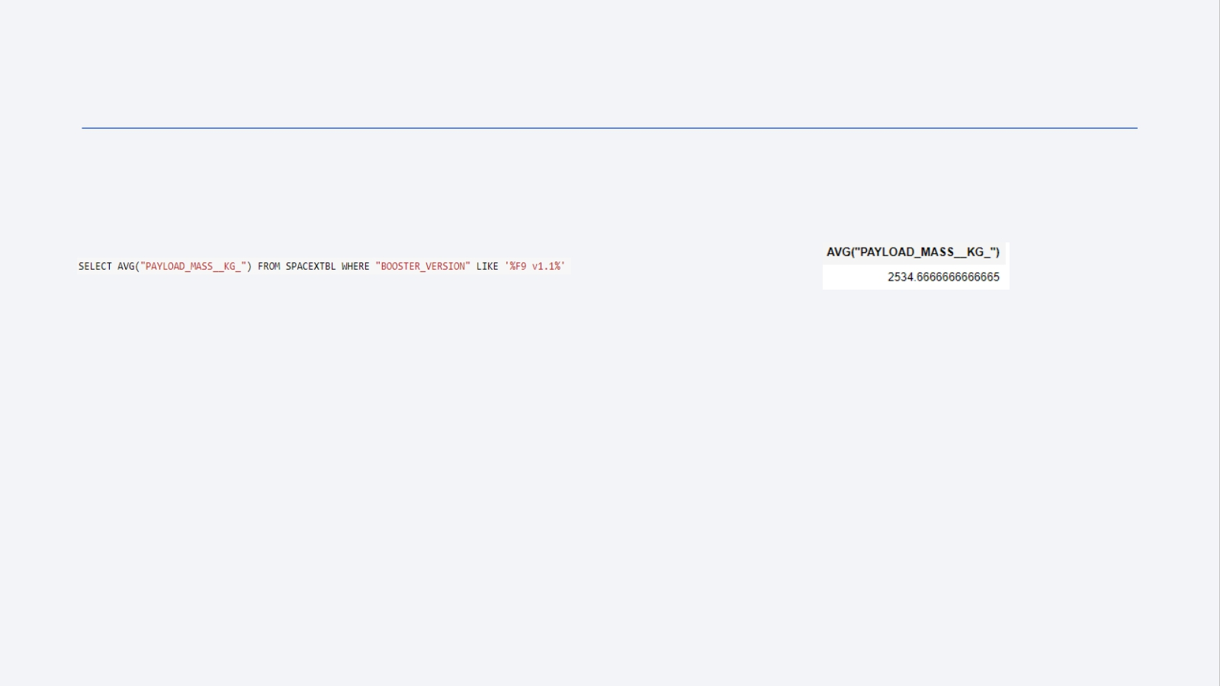
Average Payload Mass by F9 v1.1
SQL Query Results
Explanation
This query returns the average of all payload masses where the booster version contains the substring F9 v1.1.
27

Slide 28
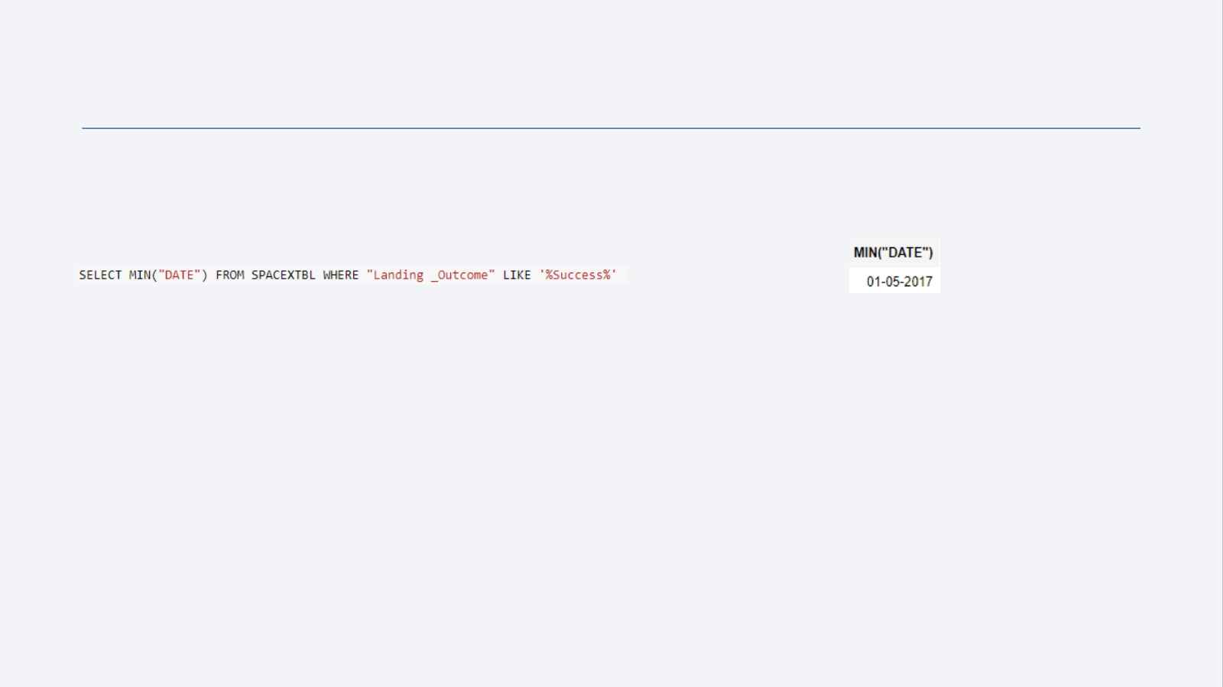
First Successful Ground Landing Date
SQL Query Results
Explanation
With this query, we select the oldest successful landing.
The WHERE clause filters dataset in order to keep only records where landing was successful. With the MIN function, we select the record with the oldest date.
28

Slide 29
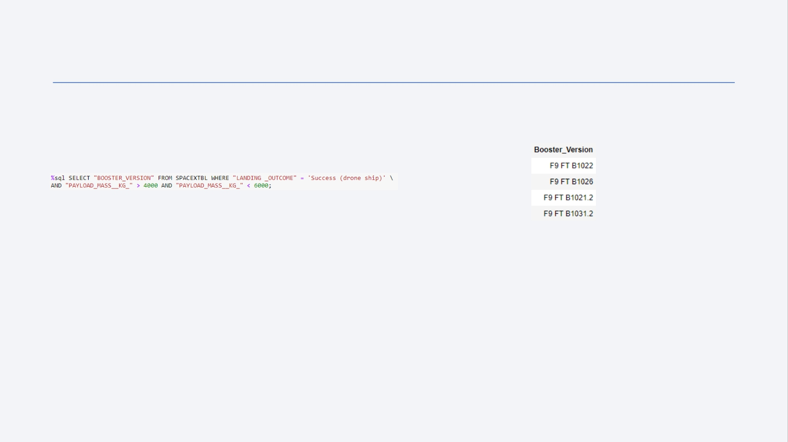
Successful Drone Ship Landing with Payload between 4000 and 6000
SQL Query Results
Explanation
This query returns the booster version where landing was successful and payload mass is between 4000 and 6000 kg. The WHERE and AND clauses filter the dataset.
29

Slide 30
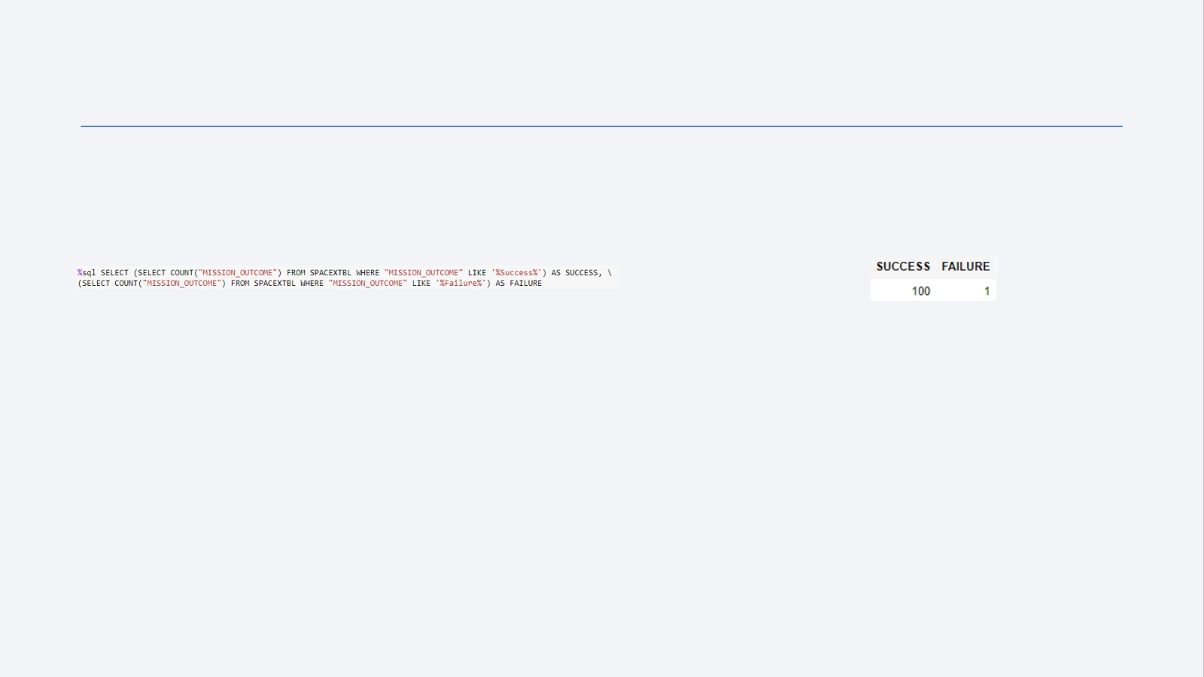
Total Number of Successful and Failure Mission Outcomes
SQL Query Results
Explanation
With the first SELECT, we show the subqueries that return results. The first subquery counts the successful mission. The second subquery counts the unsuccessful mission. The WHERE clause followed by LIKE clause filters mission outcome. The COUNT function counts records filtered.
30

Slide 31
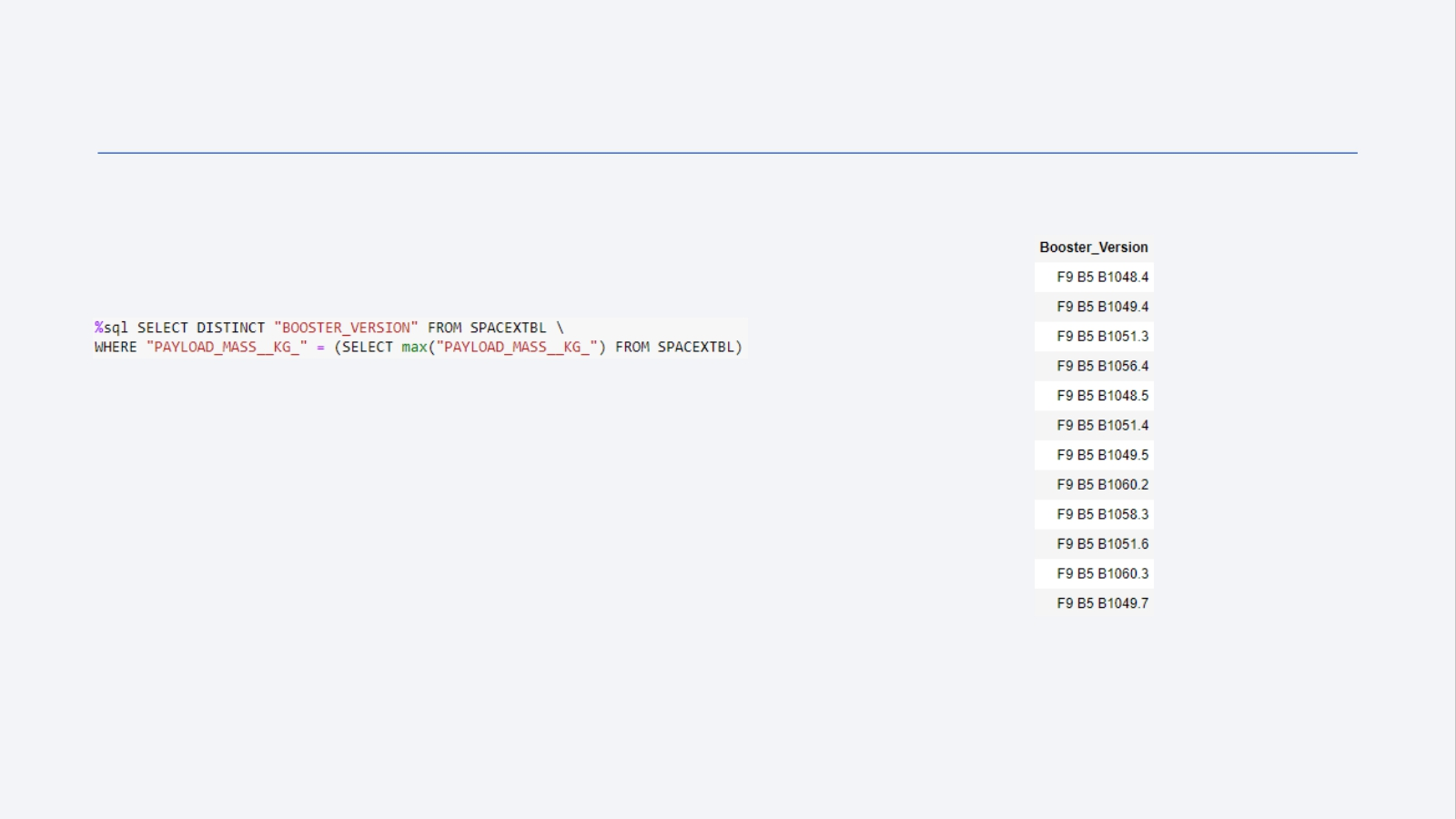
Boosters Carried Maximum Payload
SQL Query Results
Explanation
We used a subquery to filter data by returning only the heaviest payload mass with MAX function. The main query uses subquery results and returns unique booster version (SELECT DISTINCT) with the heaviest payload mass.
31

Slide 32
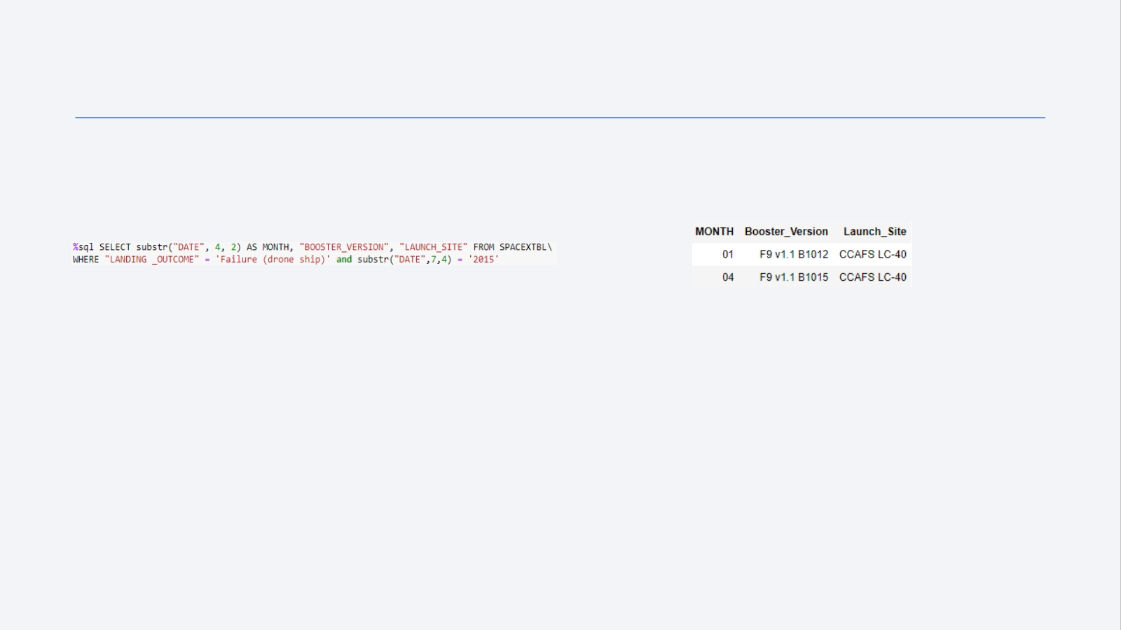
2015 Launch Records
SQL Query
Results
Explanation
This query returns month, booster version, launch site where landing was unsuccessful and landing date took place in 2015. Substr function process date in order
to take month or year. Substr(DATE, 4, 2) shows month. Substr(DATE,7, 4) shows year.
32

Slide 33
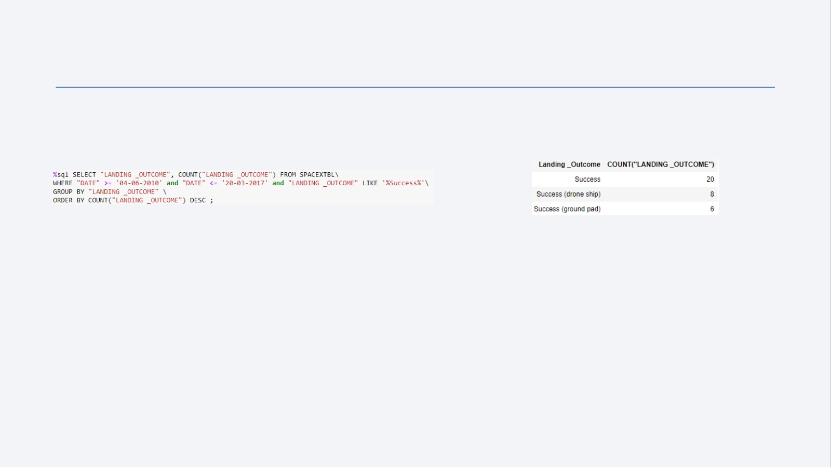
Rank Landing Outcomes Between 2010-06-04 and 2017-03-20
SQL Query Results
Explanation
This query returns landing outcomes and their count where mission was successful and date is
between 04/06/2010 and 20/03/2017. The GROUP BY clause groups results by landing outcome and ORDER BY COUNT DESC shows results in decreasing order.
33

Slide 34


Slide 35
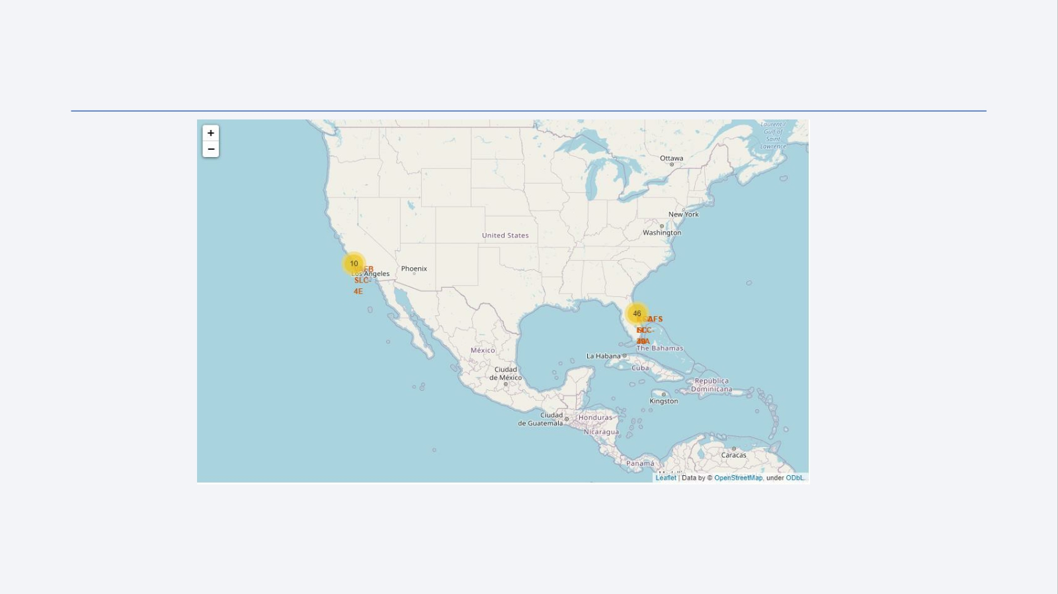
Folium map – Ground stations
We see that Space X launch sites are located on the coast of the United States
35

Slide 36
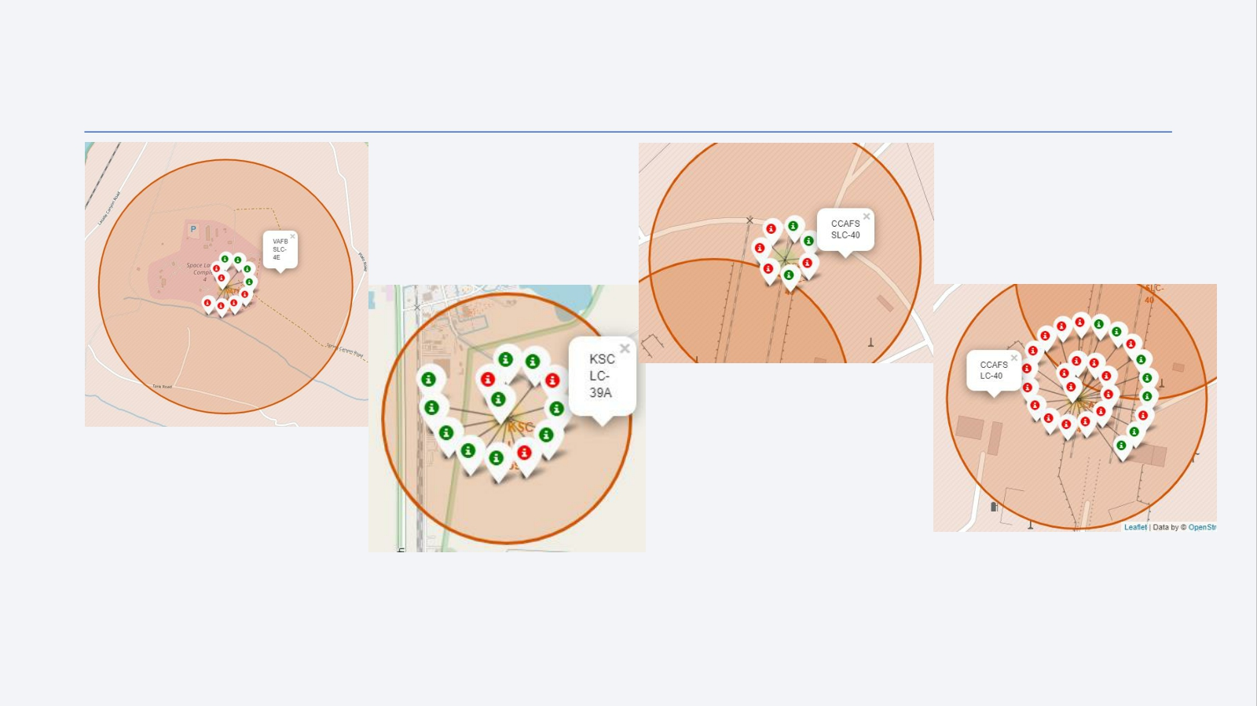
Folium map – Color Labeled Markers
Green marker represents successful launches. Red marker represents unsuccessful launches. We note that KSC LC-39A has a higher launch success rate.
36

Slide 37
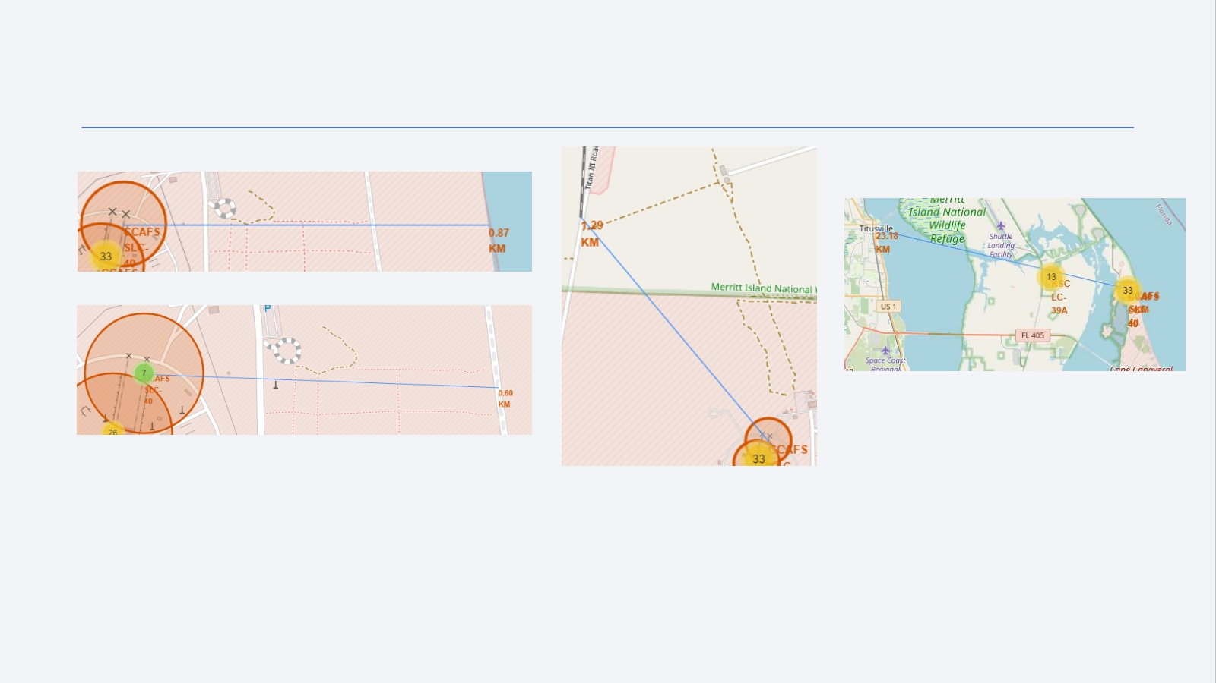
Folium Map – Distances between CCAFS SLC-40 and its proximities
Is CCAFS SLC-40 in close proximity to railways ? Yes Is CCAFS SLC-40 in close proximity to highways ? Yes Is CCAFS SLC-40 in close proximity to coastline ? Yes
Do CCAFS SLC-40 keeps certain distance away from cities ? No
37

Slide 38


Slide 39
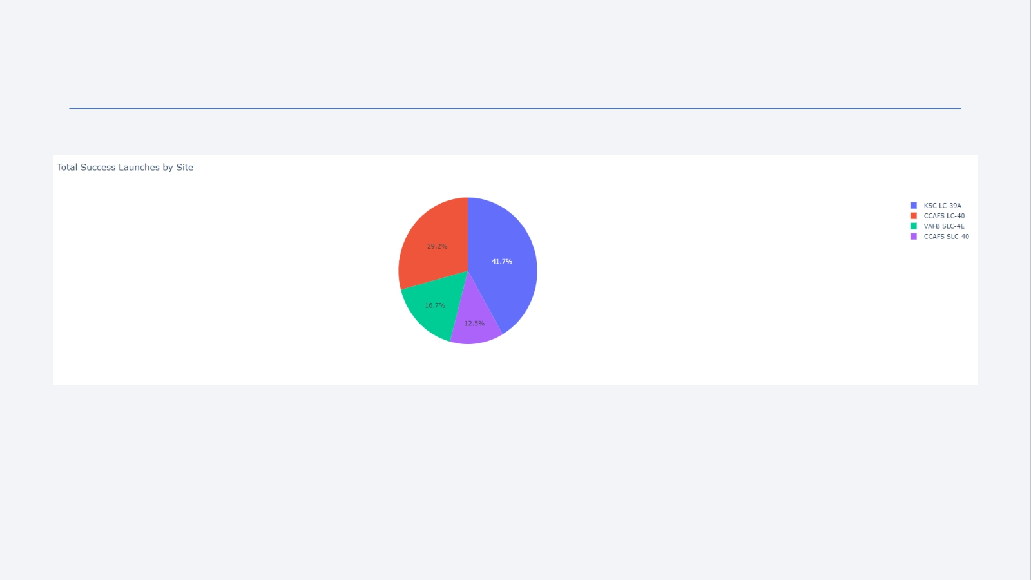
Dashboard – Total success by Site
We see that KSC LC-39A has the best success rate of launches.
39

Slide 40
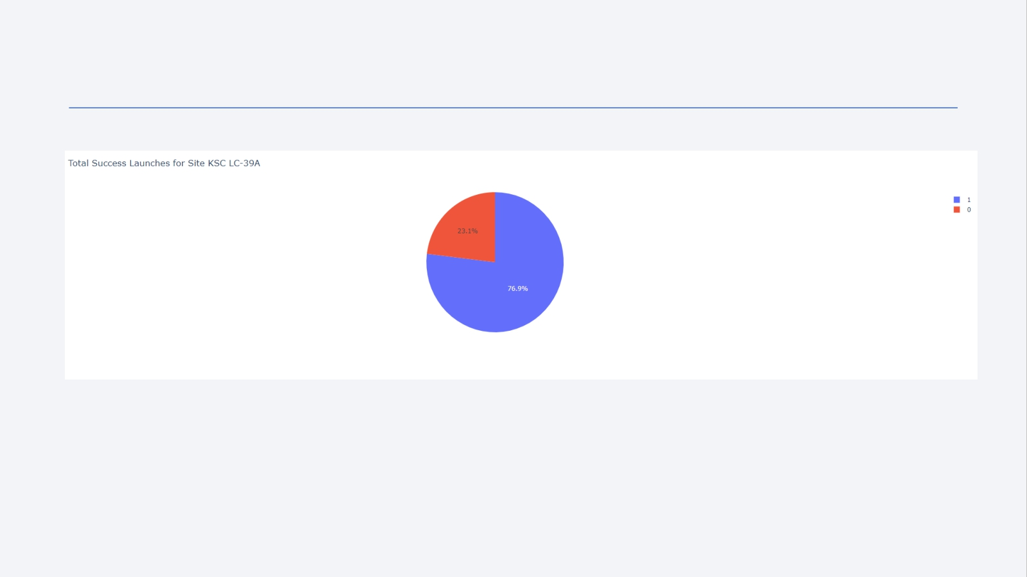
Dashboard – Total success launches for Site KSC LC-39A
We see that KSC LC-39A has achieved a 76.9% success rate while getting a 23.1% failure rate.
40

Slide 41
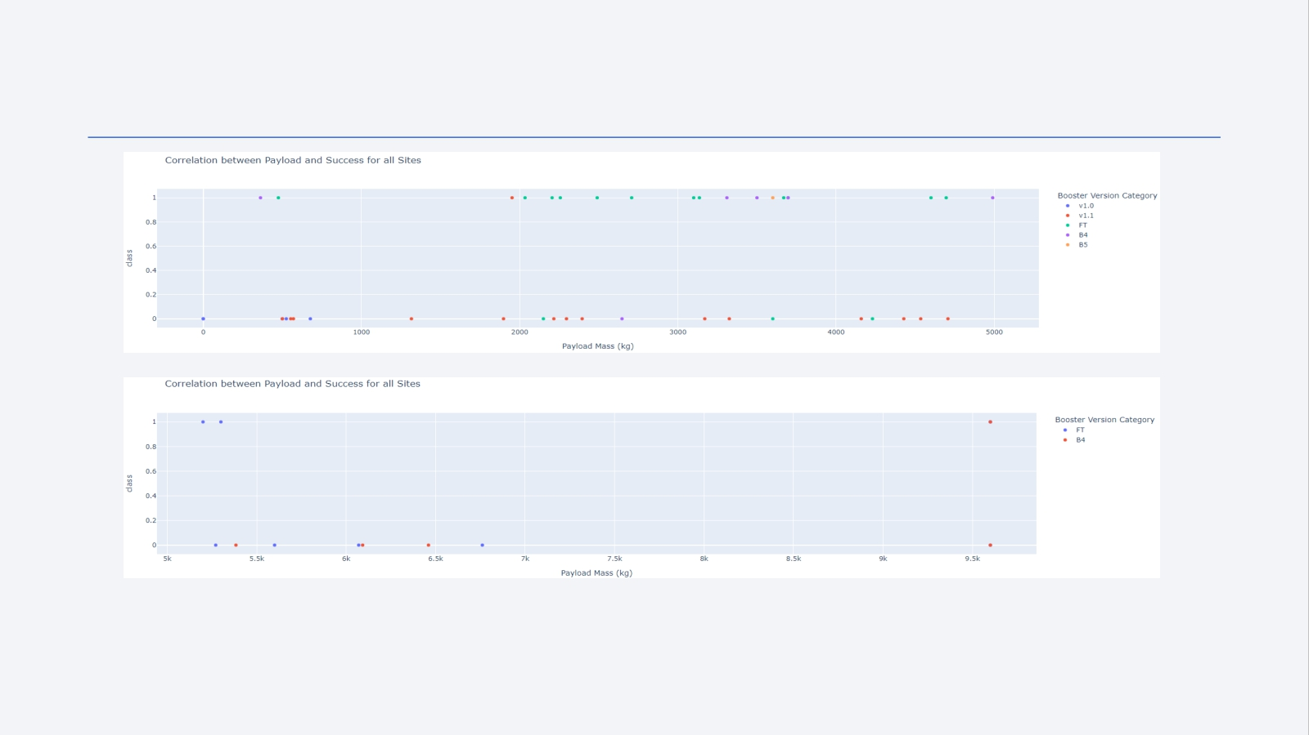
Dashboard – Payload mass vs Outcome for all sites with different payload mass selected
Low weighted payload (0 – 5000 kg)
Heavy weighted payload (5000 – 10000 kg)
Low weighted payloads have a better success rate than the heavy weighted payloads.
41

Slide 42


Slide 43
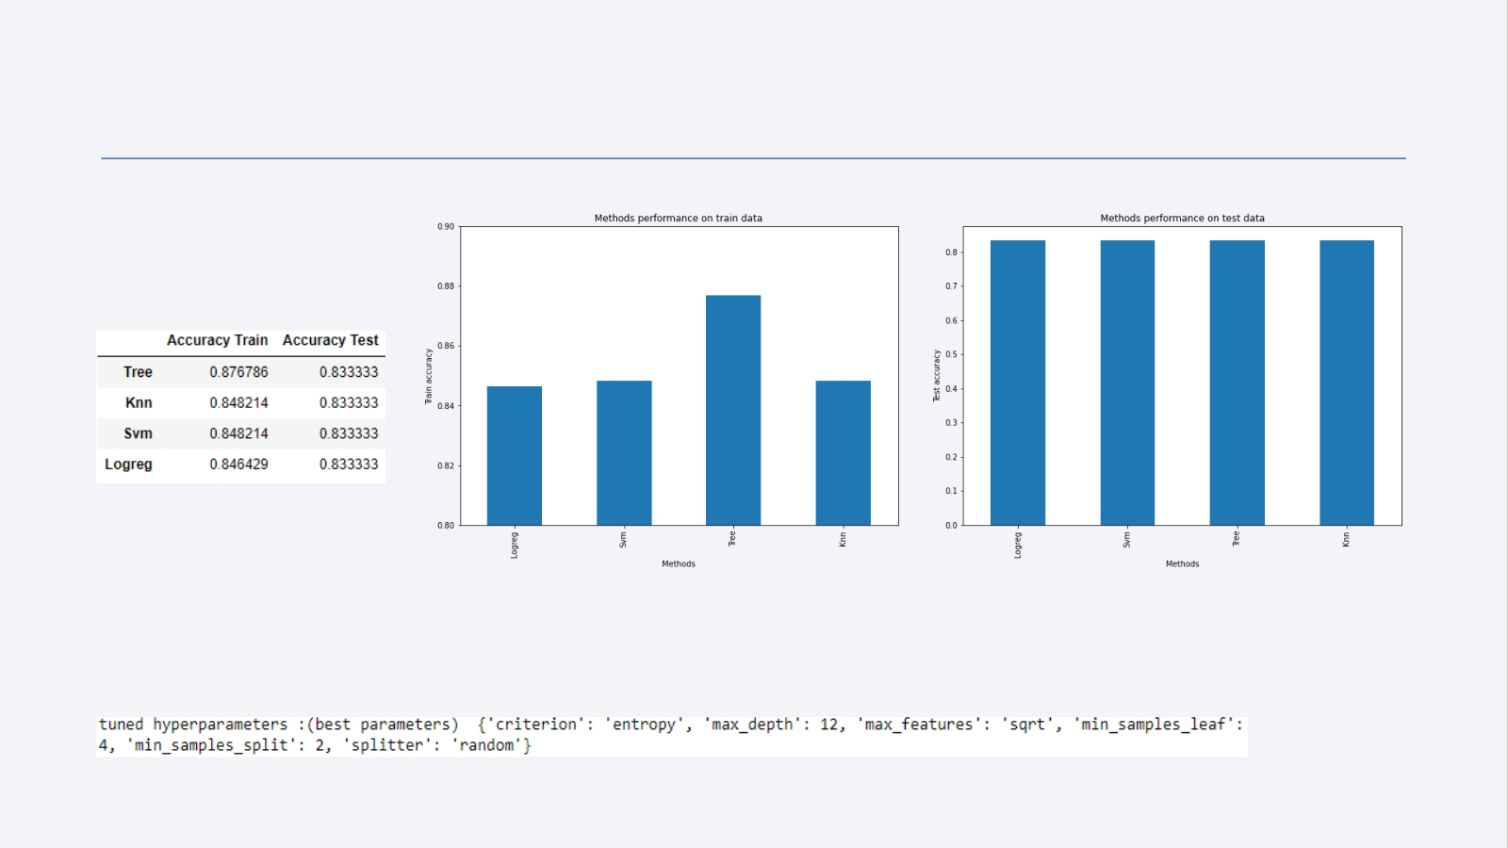
Classification Accuracy
For accuracy test, all methods performed similar. We could get more test data to decide between them. But if we really need to choose one right now, we would take the decision tree.
Decision tree best parameters
43

Slide 44
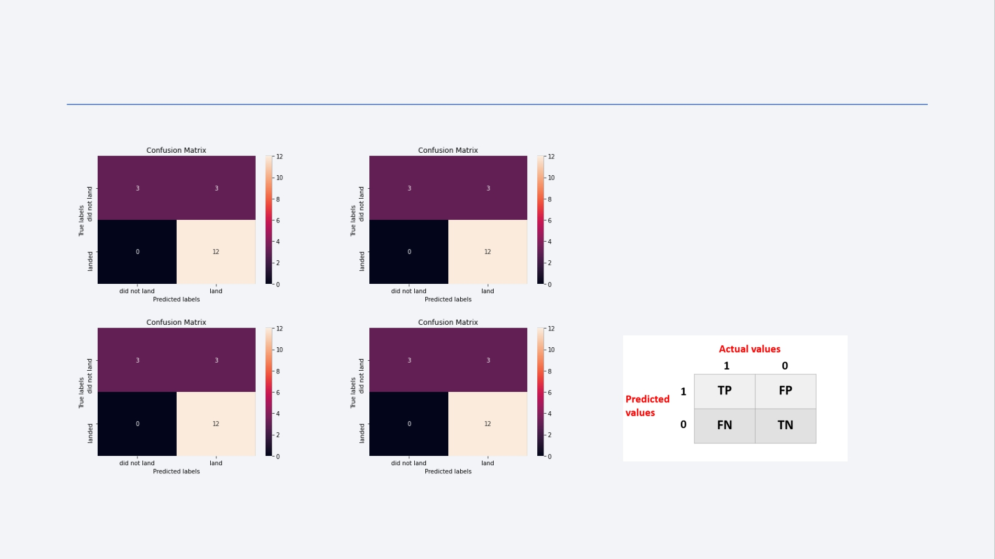
Confusion Matrix
Logistic regression
Decision Tree
As the test accuracy are all equal, the confusion matrices are also identical. The main problem of these models are false positives.
kNN SVM
44

Slide 45
Conclusions
• The success of a mission can be explained by several factors such as the launch site, the orbit and especially the number of previous launches. Indeed, we can assume that there has been a gain in knowledge between launches that allowed to go from a launch failure to a success.
• The orbits with the best success rates are GEO, HEO, SSO, ES-L1.
• Depending on the orbits, the payload mass can be a criterion to take into account for the success of a mission. Some orbits require a light or heavy payload mass. But generally low weighted payloads perform better than the heavy weighted payloads.
• With the current data, we cannot explain why some launch sites are better than others (KSC LC-39A is the best launch site). To get an answer to this problem, we could obtain atmospheric or other relevant data.
• For this dataset, we choose the Decision Tree Algorithm as the best model even if the test accuracy between all the models used is identical. We choose Decision Tree Algorithm because it has a better train accuracy.
45

Slide 46


